Slide 1
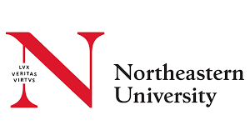
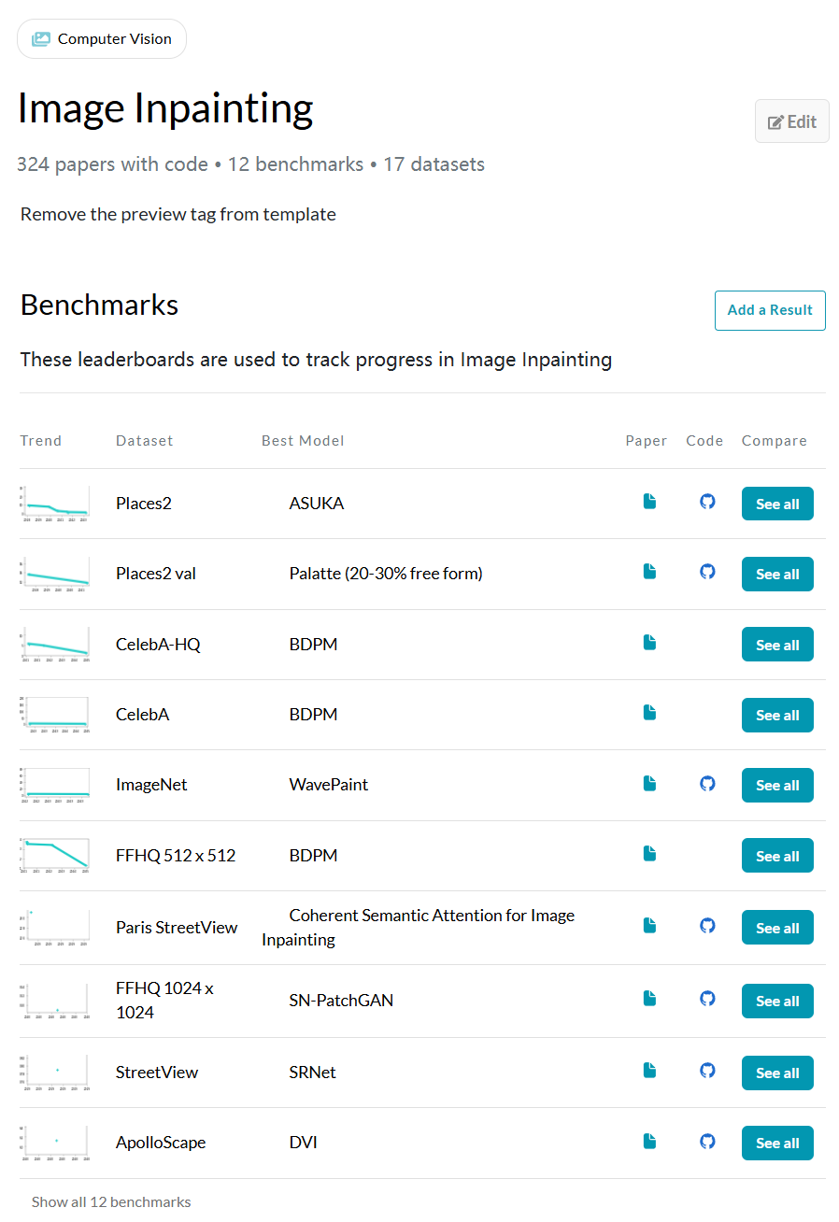
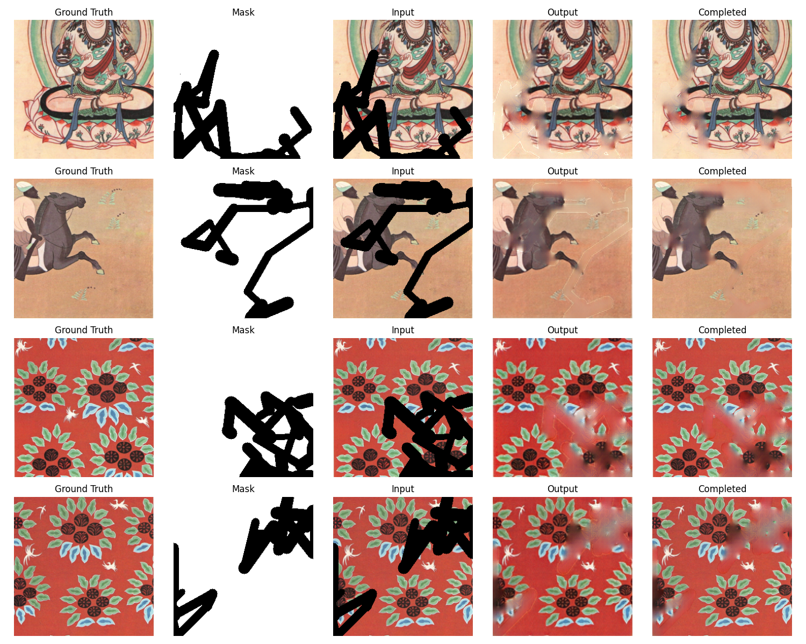
Northeastern University
INFO 7390 Final Project
Mural Inpainting
Most of the dataset are nature photo

Slide 2
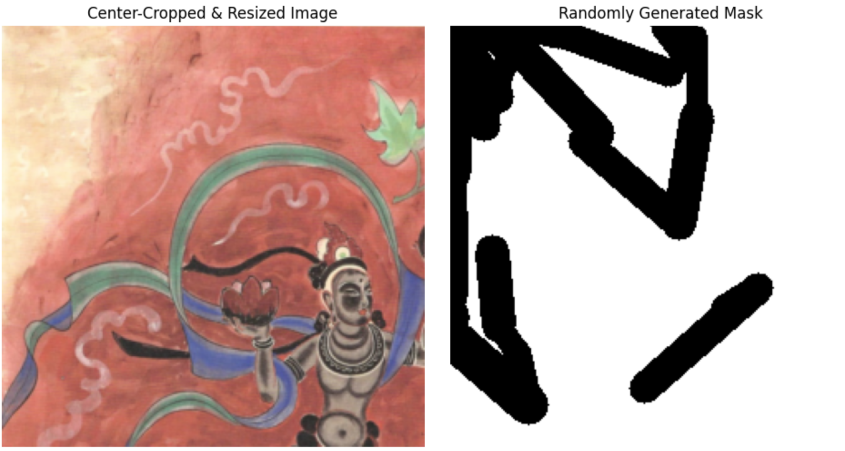
Northeastern University
DhMurals1714, a dataset published in research on line drawing guided progressive inpainting of mural damage
Train images: 1564
Valid images : 100
Test images : 50
Randomly generated masks
ratio : (0.2, 0.3]
image size(resized) : (256, 256)
https://arxiv.org/html/2211.06649v2

Slide 3
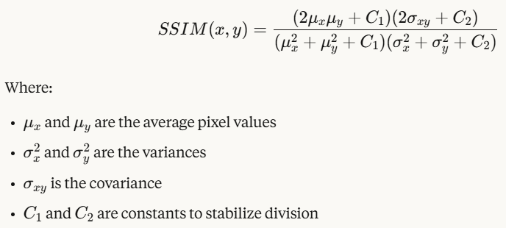
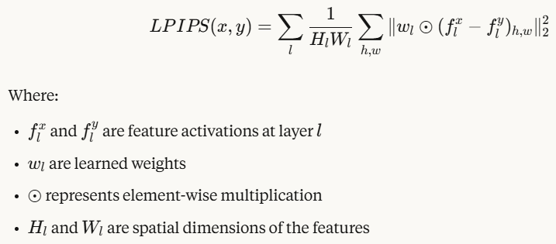
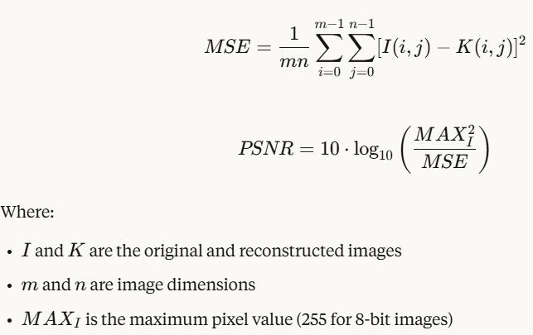
Northeastern University
Metrics for performance evaluation
SSIM measures the perceived quality of images by comparing structural information
(Higher values are better)
PSNR measures the ratio between the maximum possible power of a signal and the power of corrupting noise.
(Higher values are better)
LPIPS uses deep neural networks to measure perceptual similarity
(Lower values are better)

Slide 4
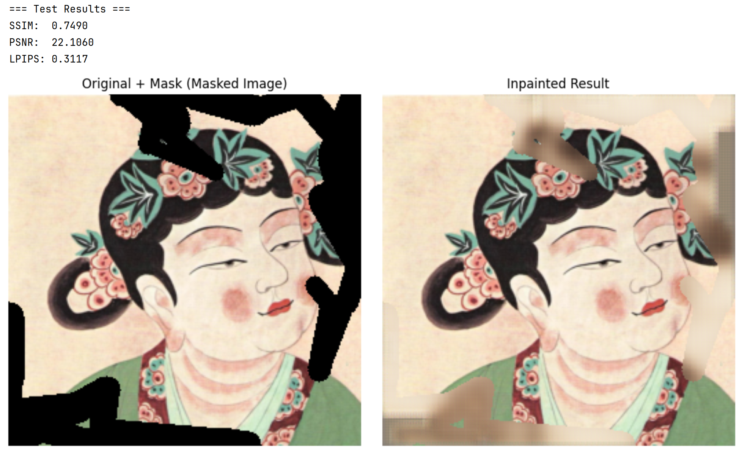
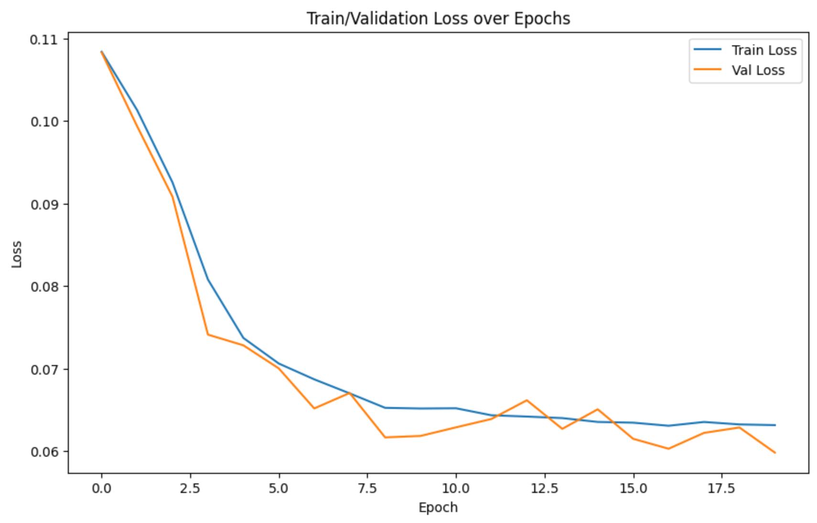
Northeastern University
Base model: Partial Convolution https://arxiv.org/abs/1804.07723
Encoder (partialconvolutions)
Channels:(3→64→128→256)
Decoder (transposed convolutions)
Channels:(256→128→64→3)
Standard convolutions treat all pixels equally
Partial convolutions are designed to handle missing data by considering only valid pixels.
loss = valid_loss + hole_loss
hole_loss = criterion(fake_B * (1 - masks), images * (1 - masks))
valid_loss = criterion(fake_B, images)

Slide 5
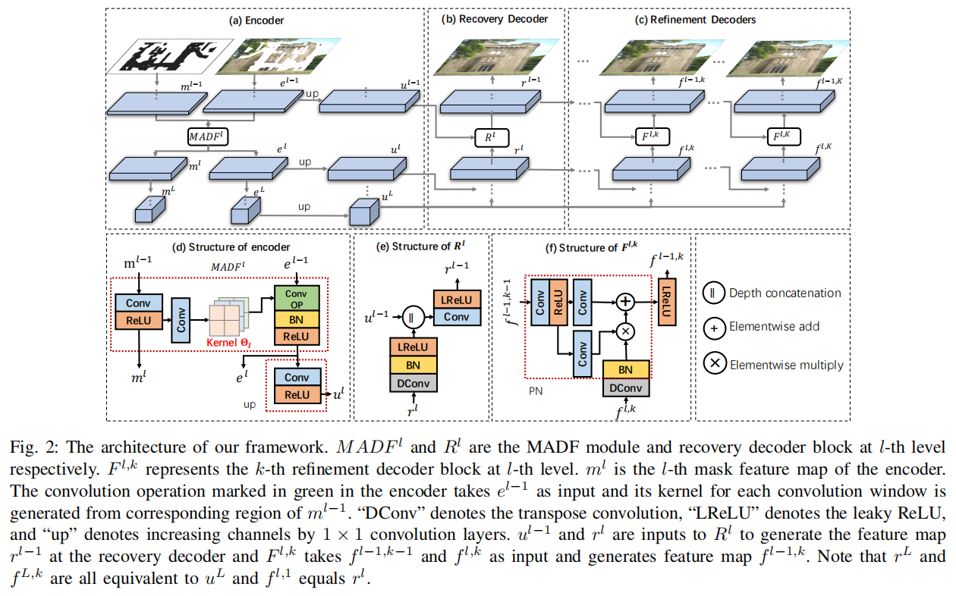
Northeastern University
MADF:Image Inpainting by End-to-End Cascaded Refinement with Mask Awareness
7th performance in Place2 benchmark https://arxiv.org/abs/2104.13743
Encoder with MADF: A specialized module generates dynamically unique convolution kernels based on mask patterns
Decoder consists of two parts: a recovery decoder and refinement decoders.
L_total = L1 + 0.05L_perc + 120L_style + 0.1L_tv, where L1 = L_valid + 6L_hole
L_perc is the perceptual loss using VGG features
L_style is the style loss using VGG features
L_tv is the total variation loss that promotes smoothness in the inpainted regions.

Slide 6
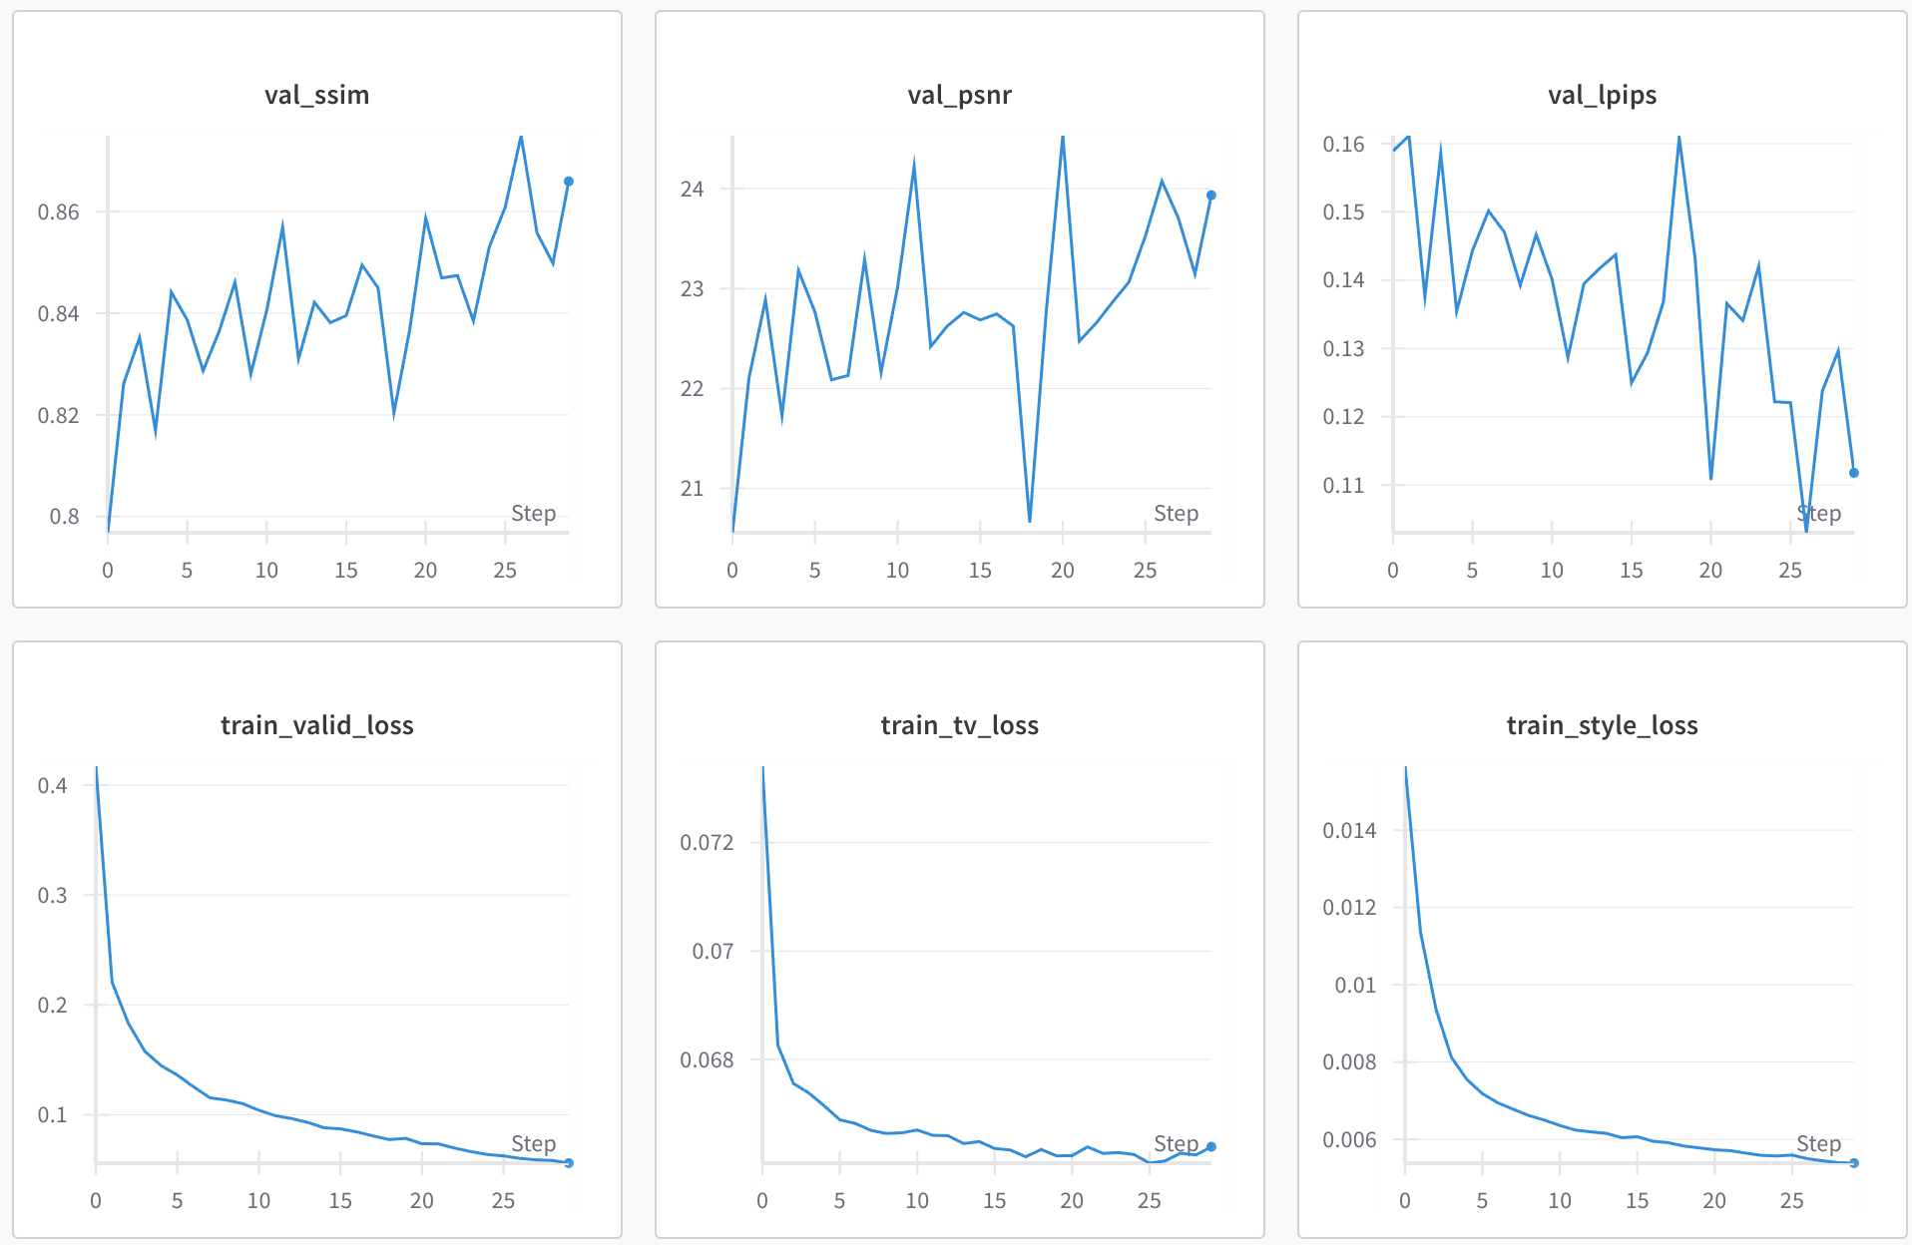
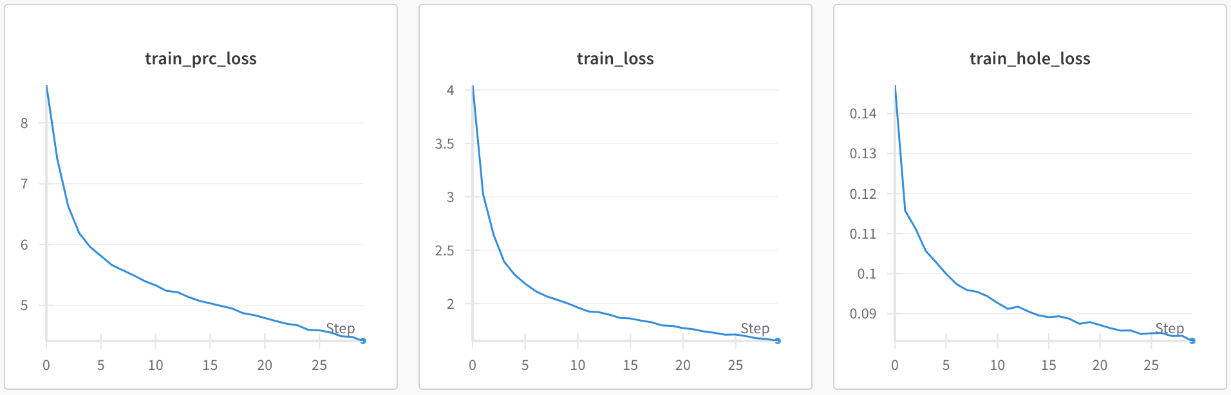
Northeastern University
MADF:Image Inpainting by End-to-End Cascaded Refinement with Mask Awareness https://arxiv.org/abs/2104.13743
Best epoch: 26
SSIM: 0.875
PSNR: 24.075
LPIPS: 0.103

Slide 7
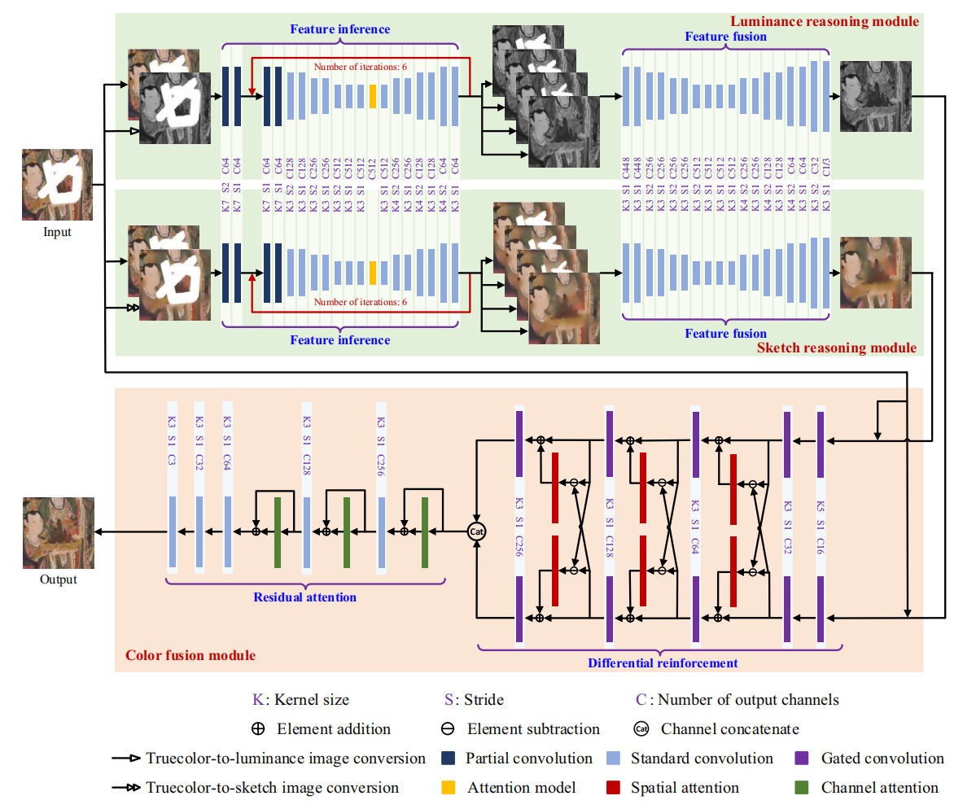
Northeastern University
PRN: progressive reasoning network and its image completion applications https://www.nature.com/articles/s41598-024-72368-1
PRN integrates the mural creation process (from sketch to coloring) into a deep learning model for the first time. This approach enhances the artistic coherence of restoration results by restoring luminance, sketch outlines, and colors in separate stages.
L_total = L1 + 0.05L_perc + 120L_style + 0.1L_tv, where L1 = L_valid + 6L_hole

Slide 8
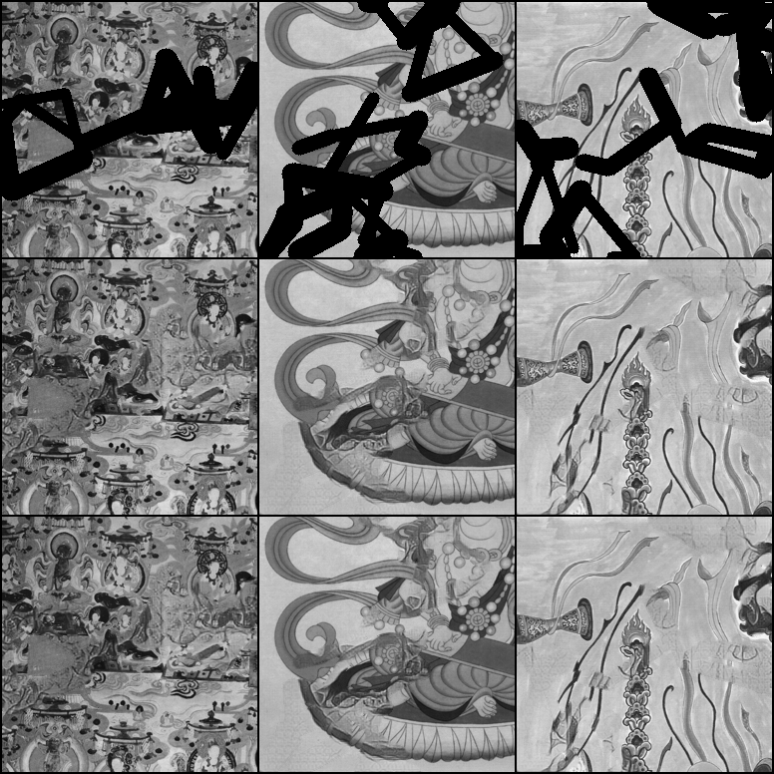
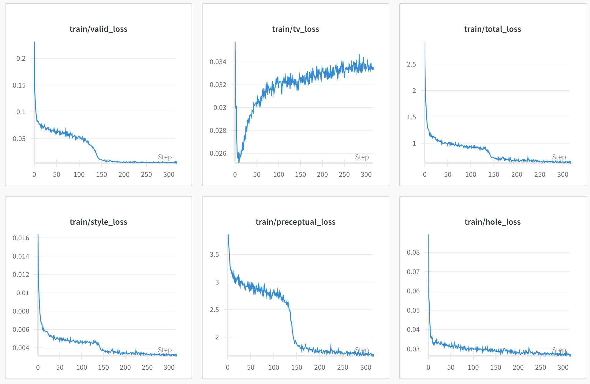
Northeastern University
PRN: progressive reasoning network and its image completion applications https://www.nature.com/articles/s41598-024-72368-1

Slide 9
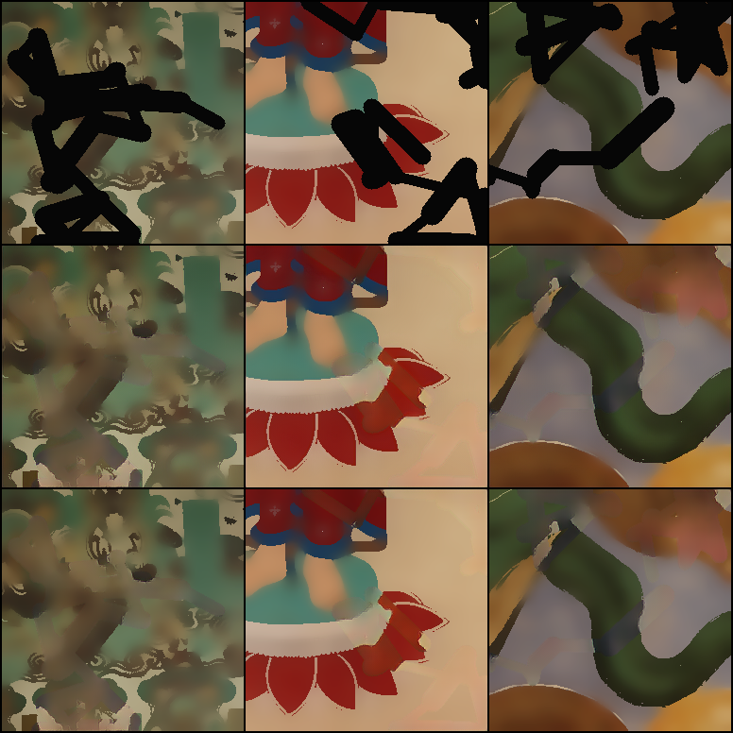
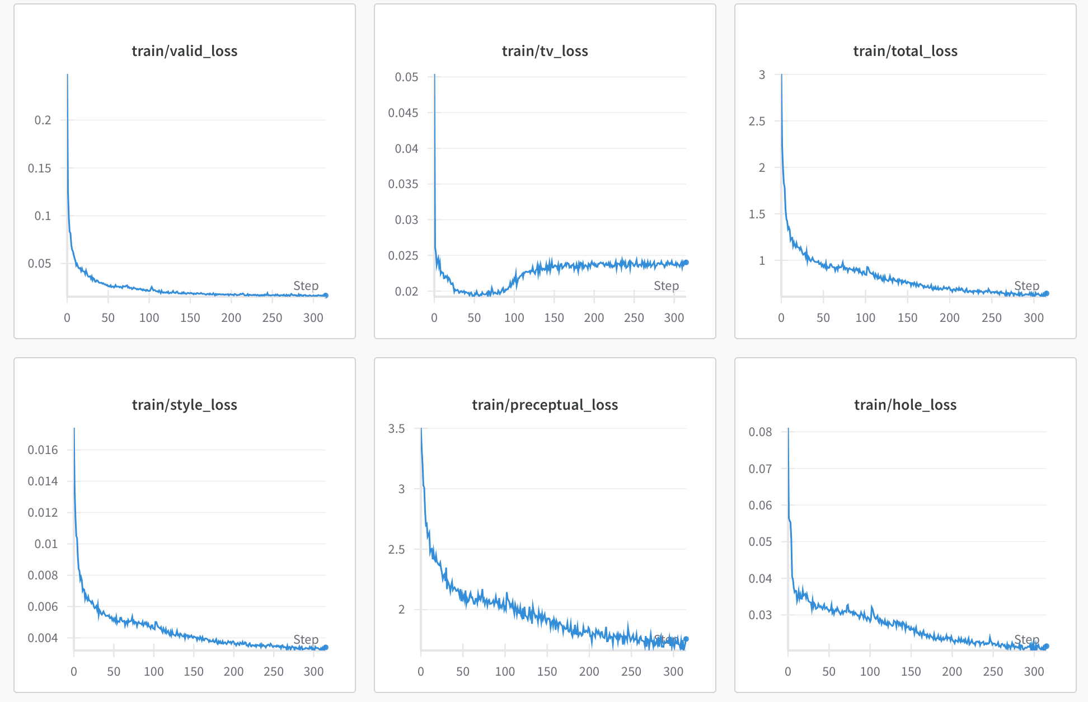
Northeastern University
PRN: progressive reasoning network and its image completion applications https://www.nature.com/articles/s41598-024-72368-1

Slide 10
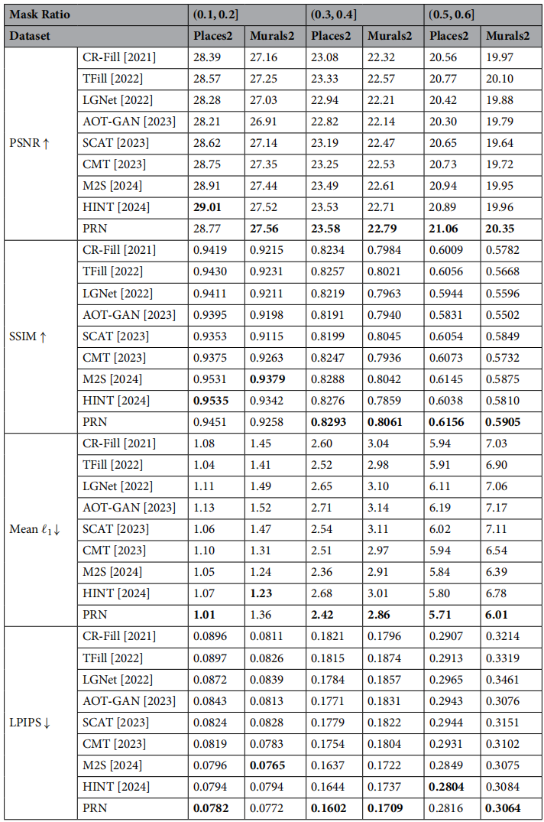
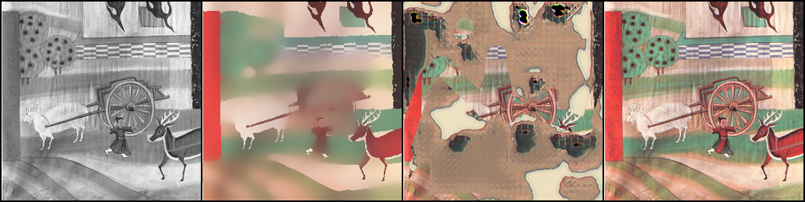
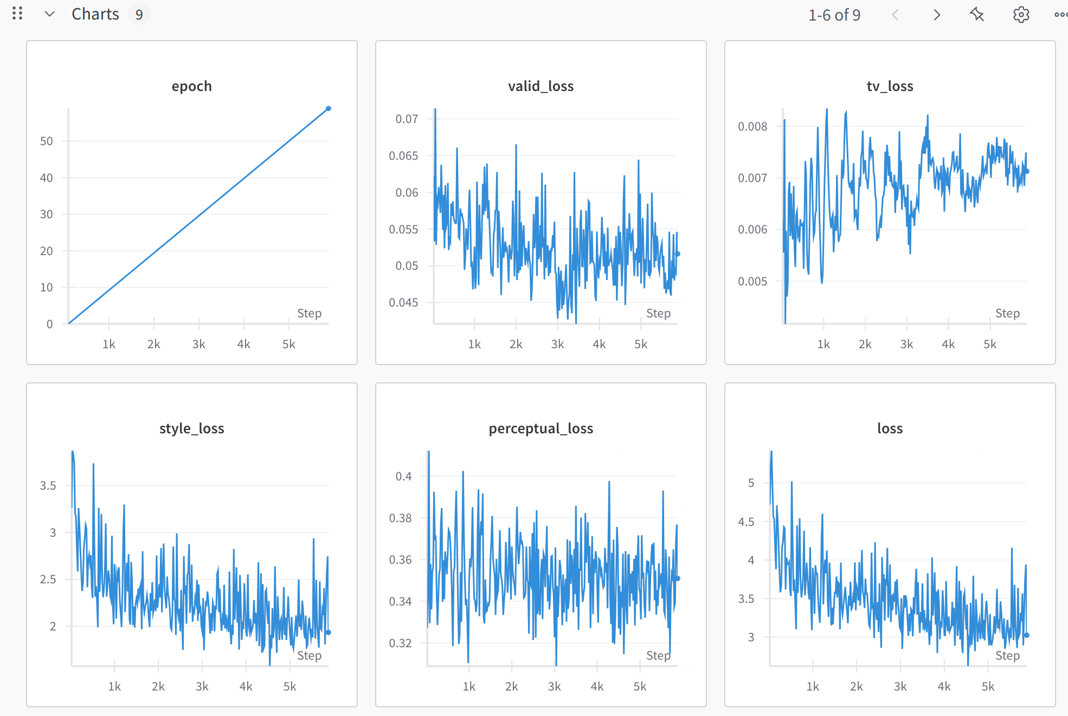
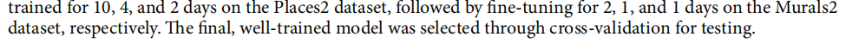
Northeastern University
PRN: progressive reasoning network and its image completion applications https://www.nature.com/articles/s41598-024-72368-1
PSNR: 15.358
SSIM: 0.456
LPIPS: 0.513

Slide 11
Northeastern University
Conclusion
Partial_conv offers the simplest approach
MADF balances complexity with effectiveness
PRN provides the most sophisticated but computationally intensive solution.
Task Suitability:
MADF works well for general inpainting
PRN is ideal for painting recovery or cultural heritage preservation.

